Slide 1


A Purposeful Walk Down Wallstreet
Michael Shields, Nabeel Asghar, Shojib Miah, Michael Chen

Slide 2





Overview
Notes:
Is there a way to improve upon the accuracy of predicting movements of financial markets?
Can previous knowledge of asset movement be used to predict future trends?
How can we maximize the value of the portfolio using trends?

Slide 3
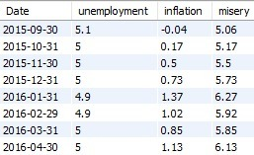
MySQL Workbench

Slide 4
Macroeconomic Variables
Inflation Rate
Unemployment Rate
Misery Index
Gross Domestic Product (GDP)
Stock Market Confidence Index
Consumer Price Index (CPI)
Treasury Bonds

